Slide 1


Name of Project :-
Crop and Fertiliser recommendation system using machine learning
Name :- SHAIK ADIL BASHA
AICTE Student Registration ID :-
STU64f0cb107a2a21693502224

Slide 2

Learning Objectives:
To understand the basics of Python programming for data analysis.
To learn and implement machine learning techniques, specifically the Decision Tree Classifier.
To analyze agricultural data and predict suitable crops and fertilizers.
To develop a system that recommends optimal crop and fertilizer combinations based on environmental and soil parameters.
To gain hands-on experience in using machine learning for real-world agricultural applications.
To enhance problem-solving and model evaluation skills using supervised learning techniques.
GOAL
Source :
www.freepik.com/

Slide 3
Tools and Technology used:
Programming Language :- Python – for data processing, model building, and visualization.
Development Environment :- Google Colab – a cloud-based platform for writing and executing Python code.
Machine Learning Library :-
Scikit-learn – for implementing the Decision Tree Classifier and other ML algorithms.
Visualization Libraries :-
Matplotlib and Seaborn – for plotting graphs and analyzing patterns in the dataset.
Additional Tools :-
NumPy and Pandas – for numerical operations and data manipulation.
CSV file handling for dataset input.

Slide 4
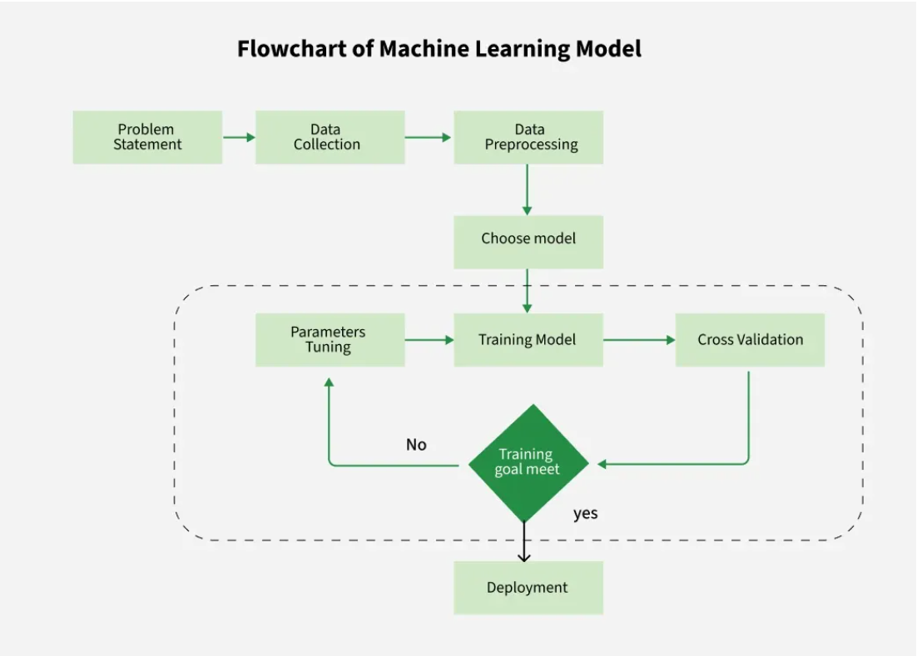
Methodology:
Our project follows a structured machine learning pipeline comprising the following stages:
Data Collection :- Collected agricultural data with features like soil type, pH, temperature, and moisture.
Data Preprocessing :- Handled missing values, encoded categories, and normalized features.
Model Building :- Used Decision Tree Classifier to link environmental factors with crop-fertilizer choices.
Model Training :- Trained the model using a split dataset (training & testing sets).
Model Evaluation :- Evaluated performance using accuracy and other key metrics.
Model Deployment :- Deployed on Google Colab for real-time crop and fertilizer prediction.

Slide 5
Problem Statement:
Farmers face challenges in selecting the most suitable crop based on soil type, pH, and climate conditions.
Using incorrect fertilizers can degrade soil quality and reduce crop productivity over time.
Traditional methods rely on experience rather than data, leading to inconsistent results.
There’s a need for a smart system that gives precise crop and fertilizer recommendations.
Our project leverages machine learning to answer: “Which crop and fertilizer are ideal for this soil and environment.

Slide 6
Solution:
Implemented an AI-based system using Decision Tree Classifier for predictions.
Achieved 98.49% accuracy in identifying the most suitable crop for given soil and climate data.
Attained 100% accuracy in recommending the right fertilizer for optimal crop growth.
The model analyzes input features like soil type, pH, temperature, and humidity.
Helps farmers make informed, data-driven decisions to boost yield and reduce resource misuse.
Git hub repo link :- https://github.com/AdilBasha18/Crop-and-Fertiliser-Recommendation-System-using-Machine-Learning
Note: If the link is not clickable, please copy and paste it into your browser, or present the PPT to enable direct clicking.

Slide 7
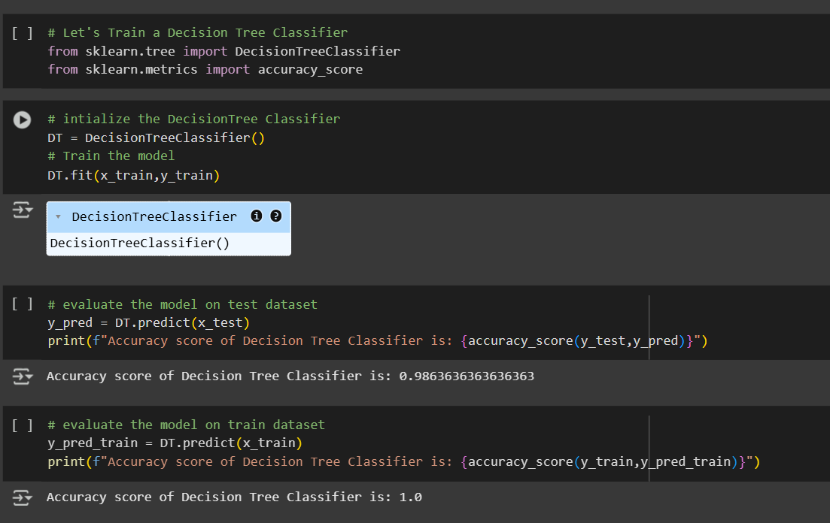
Screenshot of Output:
From Crop_Prediction.ipynb file
1. Algorithm Implementation
Shows the training of a Decision Tree Classifier using sklearn.
2. Model Evaluation
Evaluation on the test dataset shows an accuracy of 98.63%.
Training accuracy is 100%, indicating a well-fitted model.

Slide 8
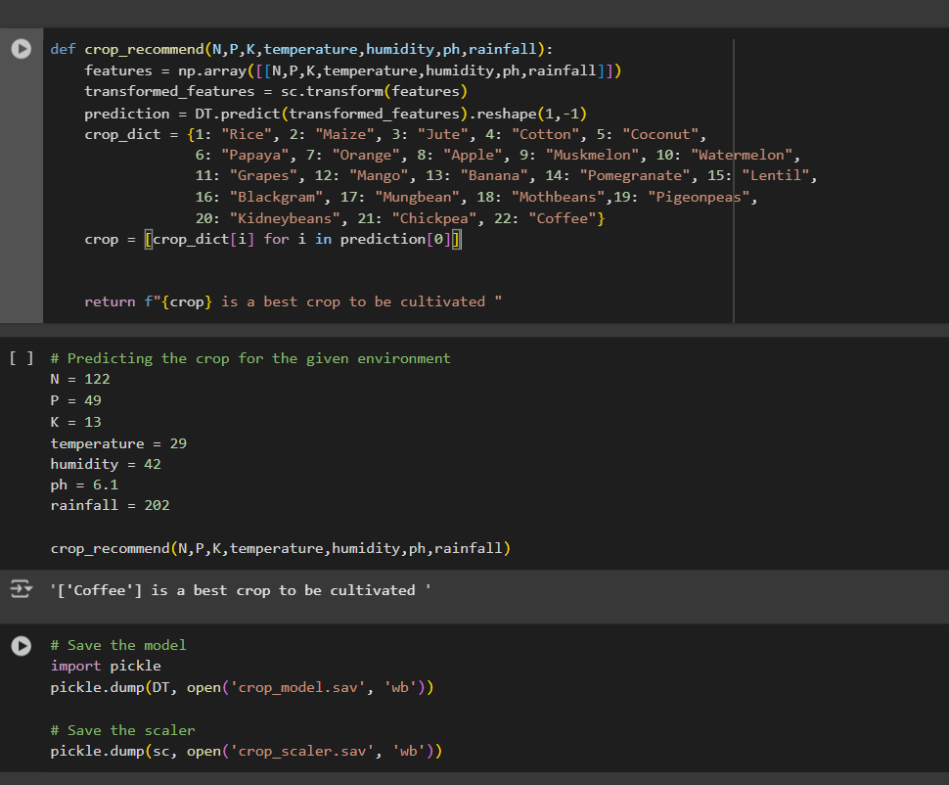
Screenshot of Output:
From Crop_Prediction.ipynb file
3. Custom Recommendation Function
crop_recommend() function takes N, P, K, temperature, humidity, pH, and rainfall as input and returns the best crop to grow.
4. Prediction Output
For given inputs, the model predicts: ‘[Coffee] is a best crop to be cultivated’

Slide 9
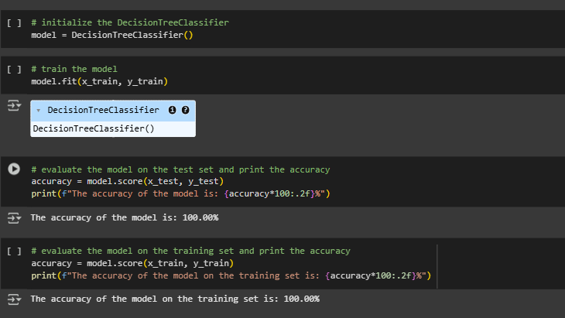
Screenshot of Output:
From Fertilizer_recommendation.ipynb file
1. Algorithm Implementation
using DecisionTreeClassifier() and model.fit(...).
Used Decision Tree Classifier to model the relationship between soil/crop conditions and suitable fertilizers.
2. Model Evaluation
both training and test accuracy are 100%, confirming a successful model.
Achieved 100% accuracy on both training and test datasets.

Slide 10
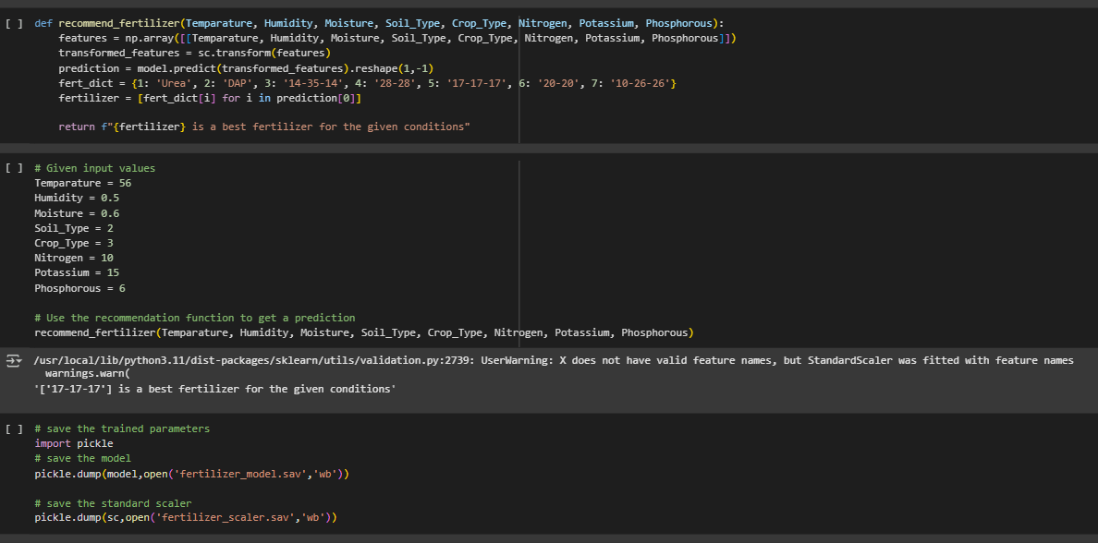
Screenshot of Output:
From Fertilizer_recommendation.ipynb file
3. Custom Recommendation Function
recommend_fertilizer(...) function uses 8 input parameters and returns the best fertilizer based on prediction.
Defined recommend_fertilizer() function to predict fertilizer based on inputs like temperature, soil type, nutrients, etc.
4. Prediction Output
output is:
['17-17-17'] is a best fertilizer for the given conditions.
For the given sample input, the model recommended: ‘17-17-17’ is a best fertilizer for the given conditions.

Slide 11
Conclusion:
Successfully built an AI-based system for predicting the best crop and suitable fertilizer based on soil and environmental conditions.
Achieved 98.49% accuracy for crop prediction and 100% accuracy for fertilizer recommendation using Decision Tree Classifier.
Enabled data-driven decision-making for farmers, improving productivity and soil management.
Simplified complex agricultural choices using machine learning and user-friendly functions.
Future Scope :-
Explore more robust models like Random Forest Classifier (RFC) for higher generalization.
Expand on Decision Tree techniques by pruning, boosting, and feature engineering for more precise results.
Integrate Deep Learning techniques for handling large-scale agricultural datasets.
Build a real-time mobile/web application for wider accessibility.
Incorporate satellite and IoT data for dynamic, location-based recommendations.

